Slide 1

ANNUAL
COMPANY
REPORT
Winslough Advertising Solutions
PRESENTED BY THE FINANCE DEPARTMENT

Slide 2
01
REPORT OUTLINE
Words from the Chairman
Key Company Goals for 2020
New Services Offered this Year
Newly Serviced Territories
Business Performance Review
Analysis
Financial Statements
TOPIC HIGHLIGHTS

Slide 3

REFLECTION AND MOTIVATION
If we boost productivity,
we can improve economic growth.
TONY ABBOTT
02

Slide 4

THE PAST 365 DAYS AS A COMPANY
Presentations are tools that can be used as lectures.
WORDS FROM OUR CHAIRMAN
03

Slide 5
100%
CLIENT SURVEY
CLIENT SATISFACTION FOR 2020
04
Presentations are tools that can be used as lectures.

Slide 6
05
INTRODUCE NEW SERVICES
Presentations are tools that can be used as lectures.
EXPAND TO NEW TERRITORIES
Presentations are tools that can be used as lectures.
RETAIN SATISFIED CLIENTS
KEY COMPANY GOALS FOR 2020
Presentations are tools that can be used as lectures.

Slide 7



06
APP PRODUCTION AND MARKETING
FULL VIDEO AD PRODUCTION
PR AND CRISIS MANAGEMENT
Presentations are tools that can be used as lectures.
Presentations are tools that can be used as lectures.
Presentations are tools that can be used as lectures.

Slide 8

CALORIE COUNTER APP
Presentations are tools that can be used as lectures.
07
IOS APP MADE FOR CLIENT, FITNESS PALS

Slide 9

30-second YouTube ad for client, Puppy Nation
Presentations are tools that can be used as lectures.
08

Slide 10
PR AND CRISIS MANAGEMENT
09
APPROACH
STRATEGY
TEAM
Presentations are tools that can be used as lectures.
Presentations are tools that can be used as lectures.
Presentations are tools that can be used as lectures.

Slide 11
SOUTHEAST ASIA
AUSTRALIA
Presentations are tools that can be used as lectures and more.
Presentations are tools that can be used as lectures and more.
MIDDLE EAST
EUROPE
Presentations are tools that can be used as lectures and more.
Presentations are tools that can be used as lectures and more.
10
Newly serviced territories

Slide 12




11
CLIENTS IN 2020
Alpine
Fresh Milk
Organix Cookies
Zyrcone Teleservices
Rubix
Motors

Slide 13
8.50%
15%
REVENUE GROWTH IN 2019
SALES OF CRIME AND MYSTERY NOVELS
12

Slide 14

13
COMPANY PERFORMANCE ANALYSIS IN 2019
Presentations are tools that can be used as lectures and more.
COMPANY PERFORMANCE ANALYSIS IN 2020
Presentations are tools that can be used as lectures and more.

Slide 15
14
MAJOR REVENUE SOURCES IN 2020
Item 5
20%
Item 1
20%
Item 5
20%
Item 1
20%
Item 5
20%
Item 1
20%
Item 4
20%
Item 2
20%
Item 4
20%
Item 2
20%
Item 4
20%
Item 2
20%
Item 3
20%
Item 3
20%
Item 3
20%
TRADITIONAL ADVERTISING
SOCIAL MEDIA ADVERTISING
CLIENT SERVICING

Slide 16

Presentations are tools that can be used as lectures.
15

Slide 17
16
QUARTERLY GROWTH IN 2020
40
30
20
10
Graphs and charts are visual aids that help add more context.
0
Item 1
Item 2
Item 3
Item 4
Item 5

Slide 18
MONTHLY GROWTH HIGHLIGHTS IN 2020
JANUARY
Presentations are tools that can be used as lectures.
MARCH
Presentations are tools that can be used as lectures.
APRIL
Presentations are tools that can be used as lectures.
17

Slide 19
REVENUE ALLOCATION
IN 2020
60
40
20
0
Item 1
Item 2
Item 3
Item 4
Item 5
Item 6
18
Graphs and charts are visual aids that help add more context.

Slide 20
19
BALANCE
INCOME
Presentations are tools that can be used as lectures.
Presentations are tools that can be used as lectures.
CASH FLOWS
SHAREHOLDERS
Presentations are tools that can be used as lectures.
Presentations are tools that can be used as lectures.
Financial Statements 2020

Slide 21




COMPANY HIGHLIGHTS IN 2020
20
Presentations are tools that can be used as lectures.

Slide 22
21
MARCHING TOWARDS
A FRUITFUL 2021
MAINTAIN STRONG CLIENT RELATIONSHIPS
Presentations are communication tools.
CONTINUE SERVICE INNOVATION
Presentations are communication tools.
ENTER NEW INDUSTRIES
Presentations are communication tools.

Slide 23


ACTIONABLE ITEMS
22
Q1 2021
Q2-Q3 2021
Q4 2021
WIDEN SERVICE PORTFOLIO
ADD COMPANY CERTIFICATION
PURCHASE LICENSES

Slide 24
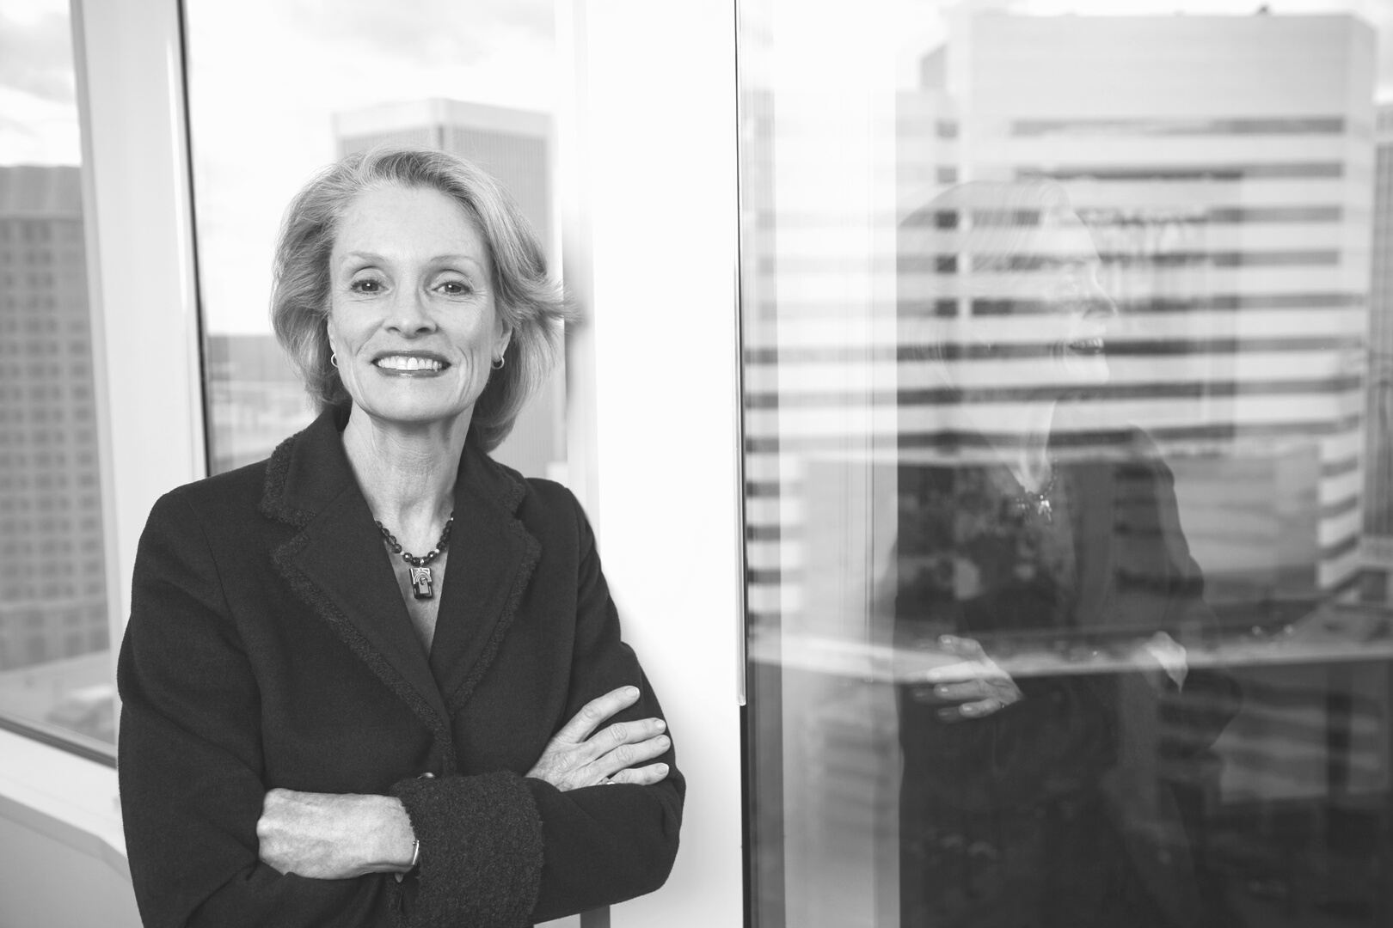


THE FINANCE TEAM
LILA DAWSON
JASON MULLER
GRACE CUDDINGTON
Senior Finance Manager
Public Accountant
23
Legal Head

Slide 25
MAILING ADDRESS
123 Anywhere Street, Any City
GET IN TOUCH WITH FINANCE
PHONE NUMBER
24
123-456-7890
EMAIL ADDRESS
hello@reallygreatsite.com

